Slide 1

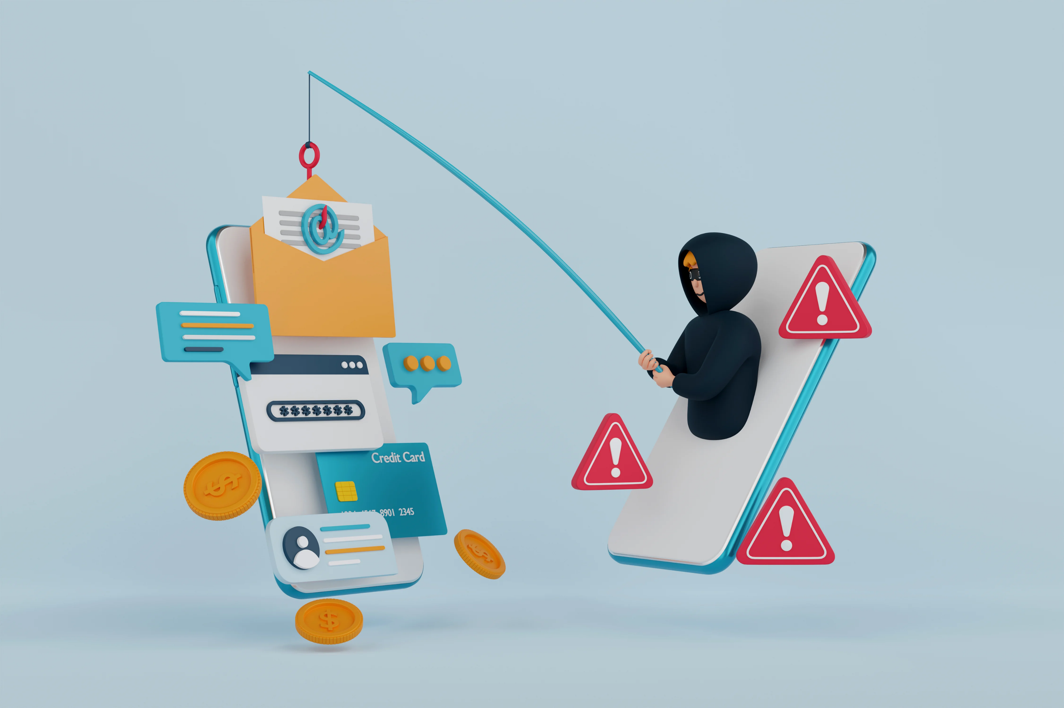
PROTECTING YOURSELF FROM PHISHING ATTACKS
RAJA SAHA

Slide 2
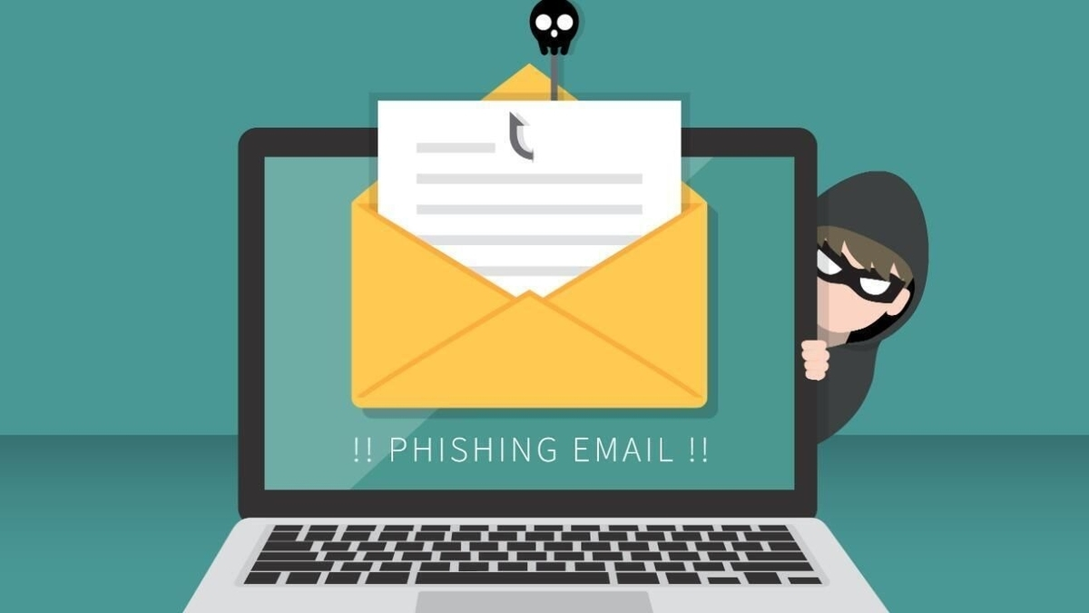
INTRODUCTION
Phishing attacks have evolved from simple spam emails to sophisticated, AI powered campaigns that can deceive even security-conscious individuals.
94% of organizations experienced phishing attacks in 2023.
Why phishing is effective- phishing succeeds because it exploits human psychology rather than technical vulnerabilities. Attackers leverage-trust and authority, urgency and fear, curiosity and greed, social proof.

Slide 3
TYPES OF PHISHING ATTACKS
Spear phishing
whaling
SMS phishing
Voice phishing
Clone phishing
Angler phishing
Email phishing
QR- code phishing
Evil twining phishing

Slide 4

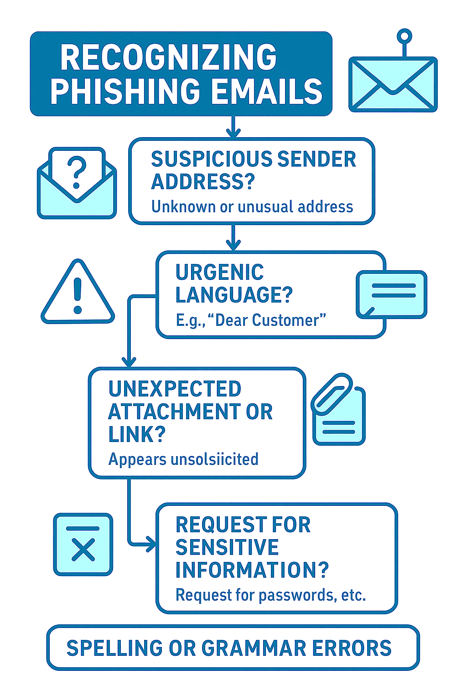
RECOGNIZING PHISHING EMAILS
Sender analysis
Content indicators
Technical Red flags
Email header Analysis techniques

Slide 5
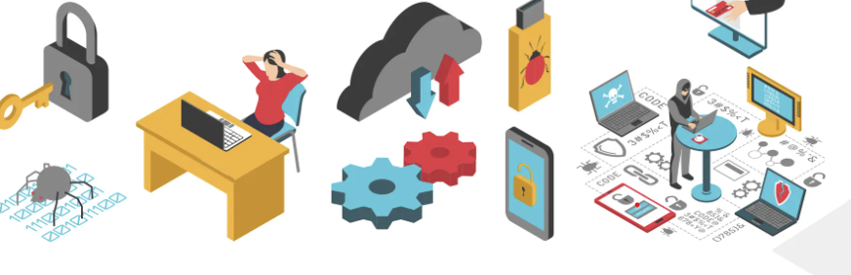
BEST PRACTICE AND PREVENTIONS
Email security best practices
When reviewing email content
Multi-factor authentication
Regular software updates
Employee training programs
Monthly phishing simulations
Just-in-time training
Gamified learning experiences

Slide 6
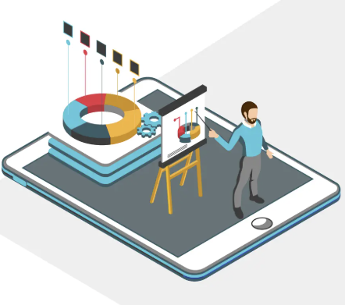
REAL WORLD EXAMPLES
Attacks-
Google and Facebook ($100 Million Loss)
Between 2013-2015, both tech giants fell victim to a sophisticated invoice fraud scheme where attackers impersonated their Taiwanese supplier, Quanta. The attack demonstrated how even large organizations with advanced security can be vulnerable to well-crafted social engineering.
Bengaluru Couple Loses ₹4.79 Crore
In June 2025, a retired engineer and his wife in Bengaluru fell victim to the largest documented digital arrest scam of the year. The couple lost ₹4.79 crore over a two-and-a-half-month period after being placed under "digital arrest" by scammers impersonating law enforcement officials.

Slide 7
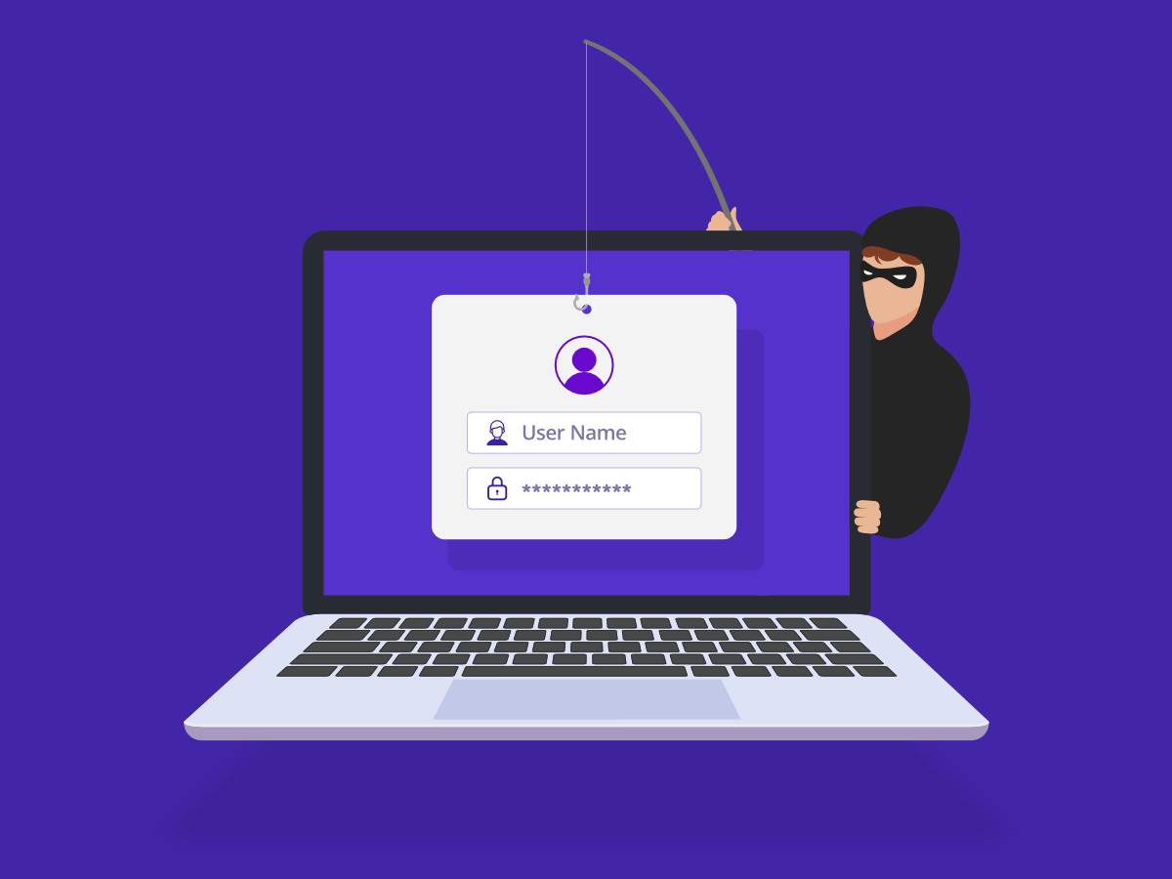
CONCLUSION
Remember: When in doubt, don't click! Report suspicious emails to your IT security team.
Phishing attacks are a growing and evolving threat that exploit human trust and technological weaknesses to steal sensitive information. They can have serious consequences, including financial loss and data breaches. Preventing phishing requires a combination of strong technical safeguards and ongoing user education. Staying alert and informed is the best defense against these attacks.

Slide 8
INTERACTIVE QUIZZES
Question 1: What is the most common red flag in phishing emails?
Poor grammar and spelling errors
Urgent language demanding immediate action
Generic greetings like 'Dear Customer'
All of the above
Question 2: Which of these URLs is most likely to be a phishing site?
https://www.amazon.com/account
https://www.amaz0n.com/account
https://amazon.com/signin
https://www.amazon.co.uk/account
Question 3: True or False
Phishing attacks only target individuals, not organizations.
Multi-factor authentication can help prevent phishing attacks.
Phishing emails often create a sense of urgency to trick users.
Technical defenses alone are enough to stop phishing attacks.
User education is an important part of phishing prevention.

Slide 9
ASSESMENTS
Phishing Simulations: Send fake phishing emails to test employee awareness and response.
Risk Scoring: Assign risk levels to users based on behavior and access.
Vulnerability Scanning: Check systems for weaknesses that phishing can exploit.
Security Culture Surveys: Measure staff attitudes and awareness about phishing.
Benefits:
Identify weak points
Target training
Improve defenses
Meet compliance

Slide 10
THANK YOU

